Slide 1
WebSphere Basics Presentation
By Rajesh and Sravan

Slide 2
What is a middle technology
Middle ware:
The software layer that lies between the operating system and applications on each side of a distributed computing system in a network.
Middle ware technology:
The technology which uses different instances like application servers, JDBC, EJB’s and Webservers to provide communication between front end to back end and lies between operating system and applications.
Different middle ware technologies:
There are more than couple of middleware technologies but below three has most successful rate
Jboss (Red hat) – Seam, JBPM, RichFaces
WebSphere (IBM) – Custom e -commerce Website
WebLogic (Oracle) - best integration with Fusion middleware, Oracle database and app

Slide 3
WebSphere technology history
WebSphere started:
IBM WebSphere has been available to the general market since 1998.
History:
WebSphere started out as HTTP server and became one of the first z/OS products running under the UNIX interfaces
In 1997, a JVM plug-in was added to run servlets
Version 4 saw the move to J2EE branding (Standalone)
Version 5 (2003) of the application server was synchronized with other platforms(NT)
Today, WebSphere is not only a J2EE application server but middleware implementing the concepts of a Service Oriented Architecture, Enterprise Service Bus and Business Process Management
OS supports WebSphere:
Command line ( Linux, Unix, Solaris and Z/OS)
Windows (Graphical OS)

Slide 4
Difference between Standalone and NT versions
 | Standalone cell | Network Deployment cell
Configuration: | Set up each standalone server node through the Profile Management Tool . Set up additional servers within the node through the administrative console or scripting. | Set up each deployment manager node through the Profile Management Tool . Add application server nodes to the Network Deployment cell through the Profile Management Tool .
Administrative isolation: | Each standalone server node is a separate administrative domain. | All nodes in the cell are in the same administrative domain and are managed by a deployment manager server.
Operational isolation: | You can start and stop servers independently. Each server has an independent, unshared JNDI namespace. | You can start and stop servers independently. The JNDI namespace is shared among all servers in the cell.
Clustering available? | No | Yes

Slide 5
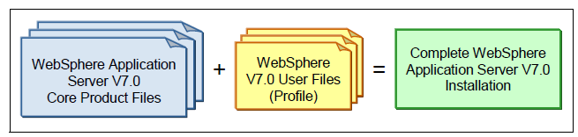
Profile’s role in WebSphere
Profile: A profile is logical container of cell, node and server, The node and server is optional in some profiles in WAS 7x
Different version of WebSphere has different futures in WebSphere 7x a new profile is added i.e. Job manager profile
Note: To create an application server, node agent, deployment manager, administrative agent, or a job manager, you must first install the WebSphere Application Server core product files and then create their respective profiles. When a profile is created, the configuration details for the server are stored in a folder that is unique to the profile. You can think of the product files as the runtime component, and the profiles as the input for the runtime.

Slide 6
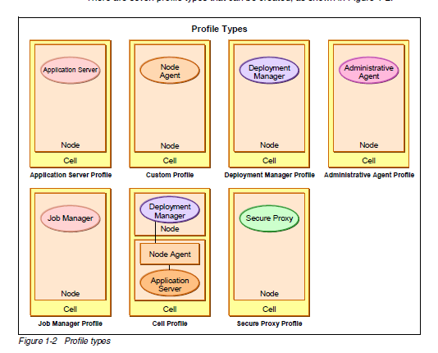
List of profiles in WAS v7

Slide 7
Difference between
WAS 5.0 : Websphere App Server , Deployment Manager and Custom Profile
WAS 6.0 : It has all the above three and extra cell profile
WAS 7.0 : It has all the above features and extra Job Manager, secure proxy and admin agent
WAS 8.0 or 8.5 : It has all the features of WAS 7.0

Slide 8
Features of WebSphere
Single point of administration
Admin console (DMGR):
One of the best feature of WAS is single point of administration, by using this we can deploy the applications on n number of JVM’s at a time which are associated with DMGR. Apart from this
The graphical interface
Selecting a scope
Updating existing items
Adding new items
Removing items

Slide 9
Features of WebSphere
Single point of administration
Saving work – synchronize -Master Repository
Getting help
Enabling security after profile creation - Security → Global security
Administrative security roles -active user registry and assigning roles
Note: We should do federation of application server to associate with DMGR this is exception for Cell profile.
In Standalone:
We need to login in to each standalone server to do any changes
Wsadmin commands will help us to do the changes with GUI mode on which it has a scope
Time taking process will not help in bigger organization
Can’t support WLM, HA

Slide 10
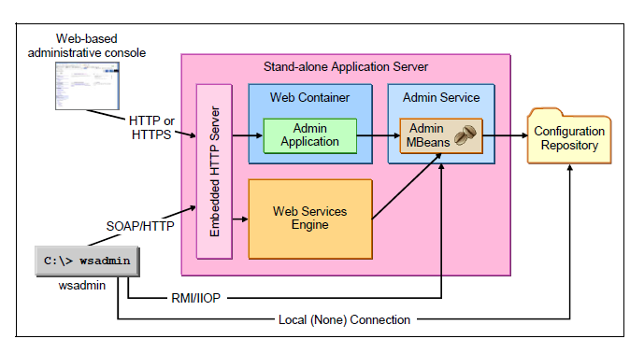
System management in Standalone single server

Slide 11
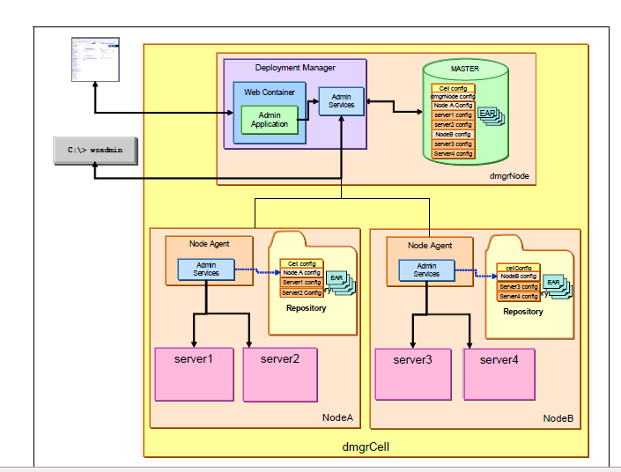
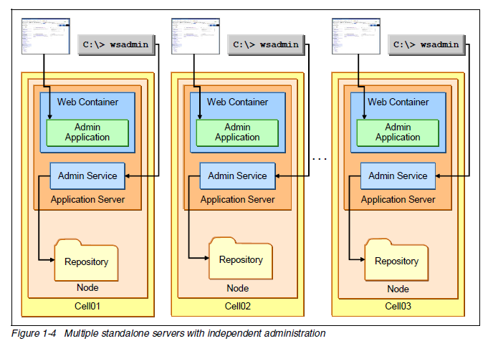
The major challenge with Standalone server
Why we need DMGR

Slide 12
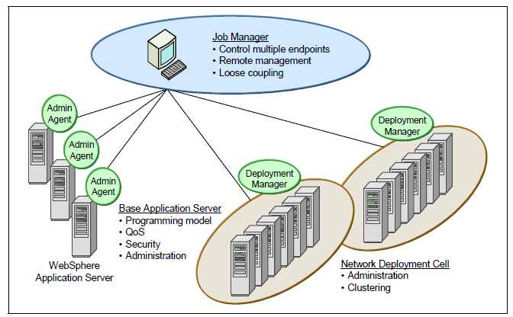
Features of WebSphere
Job Manager profile
Start and stop servers
Create and delete servers
Install and uninstall applications
Start and stop applications
Run wsadmin scripts_ Distribute files

Slide 13
Features of WebSphere
Clustering
WebSphere will work on both vertical and horizontal
Because of clustering technology WAS will accommodate HA and WLM
In WAS we can use round robin or random algorithm but most of the applications choose round robin to manage session requests.
The requests in cluster are shared according o the server weights, we can find this details in plugincfg.xml file called scalability
Plugin acts as a load balancer between Webserver and app server. It route the request according to server weights and follows chosen algorithm - Work load Management
If one server in a cluster goes down then automatically the request will be routed to another server in the cluster – High availability
WLM uses information from the HA Manager Bulletin Board

Slide 14
Security
SSL (secure socket Layer)
Keystore
Trustore
Global security
We can discuss more about this in our advanced level discussion

Slide 15
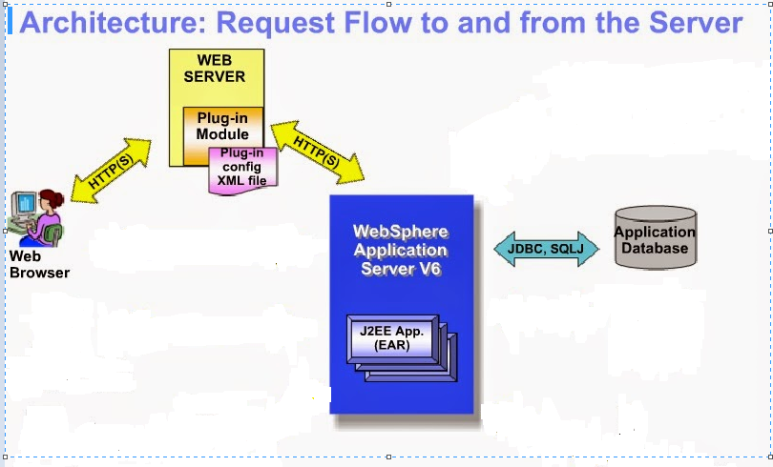
Request flow in WebSphere
Request flow - three tier architecture

Slide 16
Question and answers

